Slide 1





Brought to you by:
NZIOB WEBINAR
Leading and supporting teams through COVID-19
Presented by: Kyle McWilliams, Executive Educator, McWilliams Consulting

Slide 2

ODE-C Process
You can apply this to any context you are in, at anytime, anywhere to help you move forward (even when there is no answer).
Open to the current context.
Deliberate and flexible in your decisions and actions to what matters.
Empathetic with everyone - especially yourself.
Calm and slow.

Slide 3
Leadership Suggestions
Look After Yourself
Model Key Behaviours
It’s All About People
Create a Strong Purpose for the Organisation
Communicate Effectively

Slide 4
Our Roadmap Through This

Slide 5
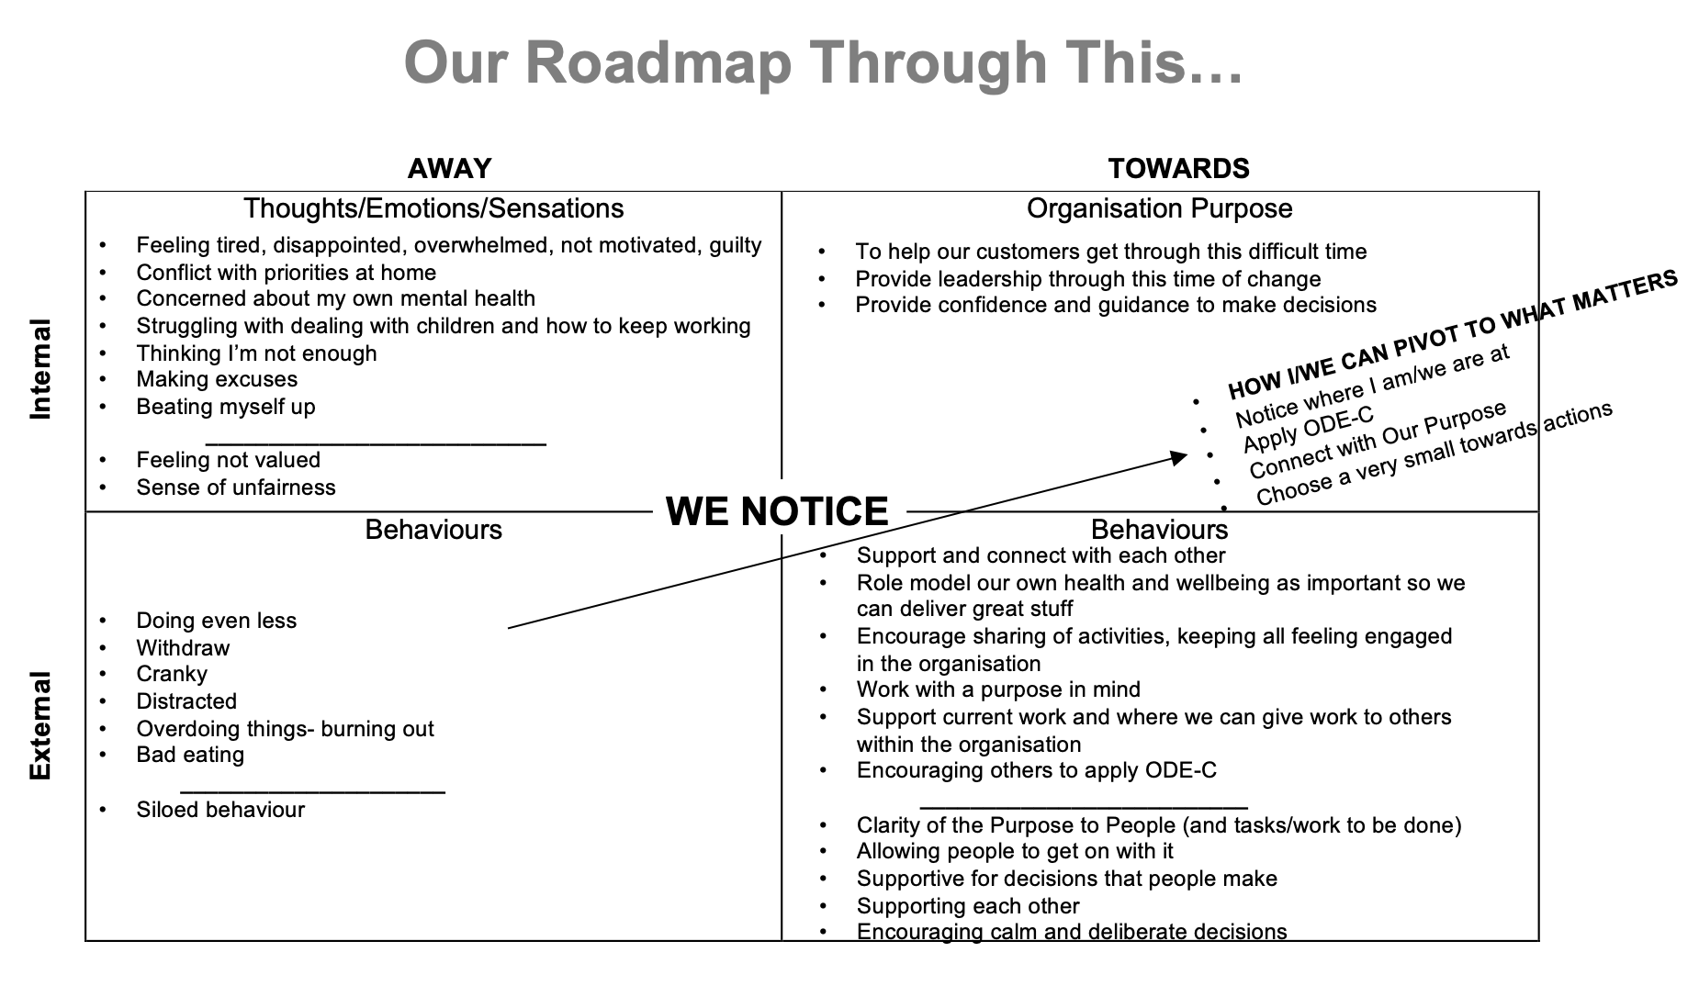
Real Examples of a Roadmap

Slide 6
Our Roadmap Through This

Slide 7
Real Examples of a Roadmap

Slide 8
Q& A

Slide 9
Thank you
A recording of this webinar will be available to
NZIOB Members on the NZIOB Members’ portal.
To enquire about NZIOB Membership, please email nziob@nziob.org.nz or visit nziob.org.nz/membership.
Brought to you by:

