Slide 1
NZIOB WEBINAR
Brought to you by:
Getting site-ready for COVID-19 Alert Level 3
Presented by:
Chris Alderson, CEO, CHASNZ Mike Jeffery, Senior Associate, RCP Christchurch Tom Pyatt, Project Manager, Naylor Love Canterbury

Slide 2
Level 3 – Restricted Workers Bubble
Paragraph (

Slide 3
Covid-19 Management Plans
Producing planning documentation
Keep our objective in mind
Use a chronological format
Assign responsibility
Incorporate CHASNZ’s infographics
Ensure the document is updated

Slide 4
Creating separation on site
To plan the work on site, consider:
Firstly - what work or tasks would you or your team(s) like to do?
Then - where and how would you or others undertake their task?
What do you need to change to safely undertake that task in Level 3?
How will we establish and maintain administrative controls to enforce the protocols?

Slide 5
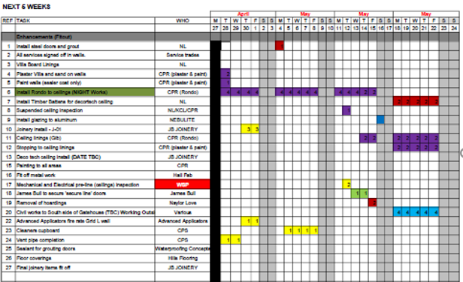
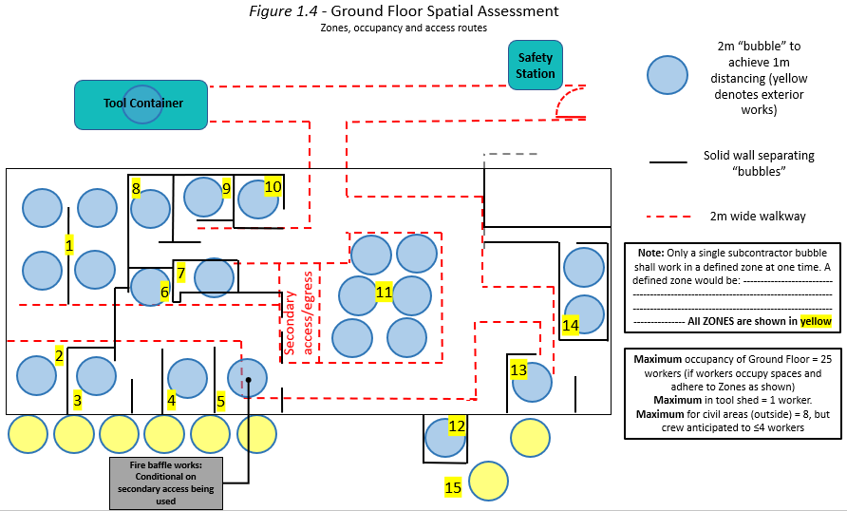
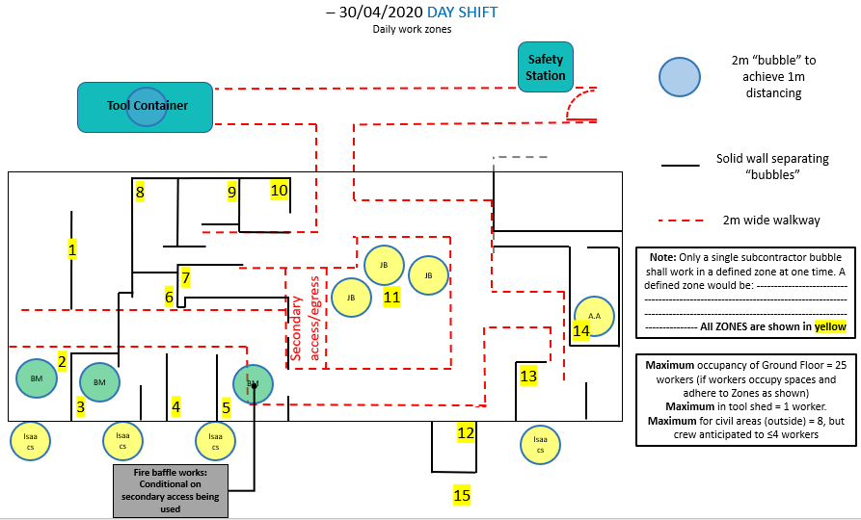
Examples of planning:
:
Look-ahead schedules
Spatial Assessments
Daily work plans
Alter the sequence, methodology or timing of the task to ensure compliance with Level 3 protocols. Some tasks simply will not be possible at Level 3
Tasks will take longer than usual, and that’s OK!

Slide 6
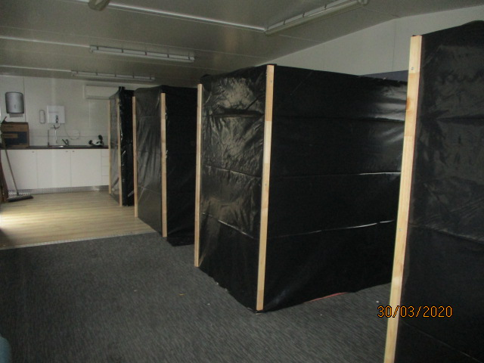
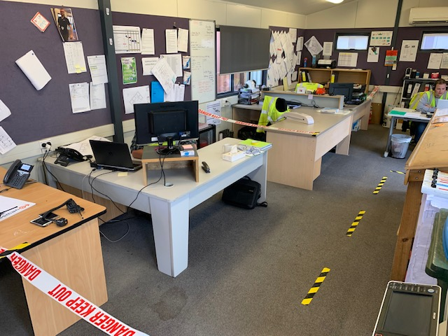
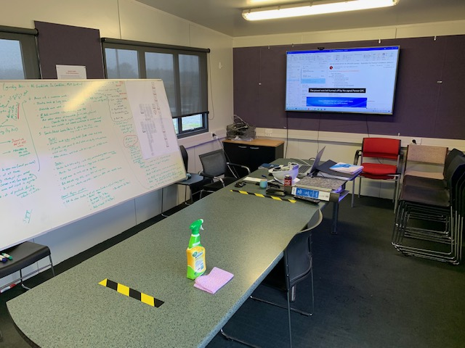
Examples of separation:
Temporary facilities
Site Offices
Repurposing spaces

Slide 7
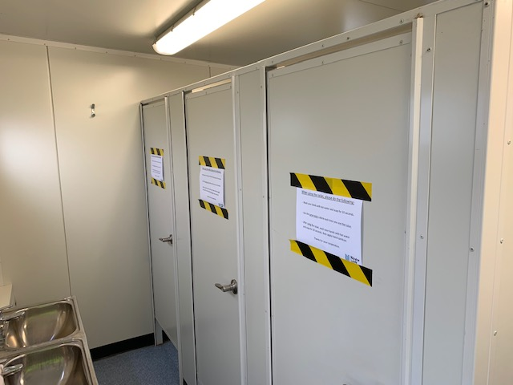
Compliance and worker Engagement
Distribution of planning documents – make sure they’re circulated
Seek and act upon feedback from anyone
Lead by example, and don’t deviate
Actively monitor compliance; coach workers
Use signage to reinforce protocols

Slide 8
Lessons learnt
Work face bubbles are more resilient than split shifts,
Have a back up plan,
Be prepared to reduce the number of tasks,
Test isolation and tracing procedures,
Keep supervision within the work face bubble,
Track performance of the controls, it will not be perfect first time around.

Slide 9
Q& A

Slide 10
Thank you
A recording of this webinar will be available to NZIOB Members on the NZIOB Members’ portal.
To enquire about NZIOB Membership, please email nziob@nziob.org.nz or visit nziob.org.nz/membership.
Brought to you by:
With thanks to:

